Slide 1

PRESENTATION
Technical Writing
PRESENTED BY
Kamana Shrestha
Gaurav Thapa
Hrikesh Aron
Aayush Shah
1

Slide 2
Presentation
Introduction
Getting Started on a Presentation
Planning
Organizing and Composing (audience and topic, graphic aids, organization, and composition.)
Kamana Shrestha
Gaurav Thapa
Preparing (outlines and notes, personal appearance)
Different methods of rehearsal.
Group Presentation
Presenting
Hrikesh Aron
Ayush Shah
1

Slide 3


Introduction
Kamana Shrestha
A presentation is a planned oral communication delivered to an audience.
Purpose: to inform, explain, persuade, or demonstrate.
Effective presentations combine clear content, organization, delivery, and visual support.
In technical writing, presentations help communicate technical information clearly and efficiently.
2

Slide 4


Getting Started on a Presentation
Kamana Shrestha
Typical readers or listeners
Identify who will receive the message.
Consider their knowledge, interests, needs, and expectations.
Writer's focus
Define the purpose and main message.
Choose information appropriate for the audience.
Focus on clarity, accuracy, relevance, and audience understanding.
3

Slide 5

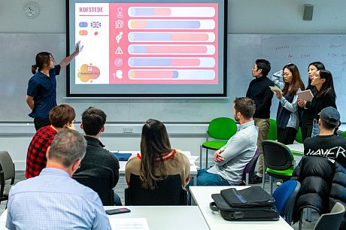
Presentation: Types
Kamana Shrestha
Individual Presentation
Presented by a single speaker.
One person is responsible for delivering the entire topic.
Group Presentation
Presented by two or more speakers.
Proper planning, coordination, communication and practice.
3

Slide 6

Organizing a Group Presentation
A group presentation involves two or more speakers working together to present one topic.
Successful group presentations require planning, coordination, communication, and practice.
Each member should understand their responsibilities and the overall structure.

Slide 7

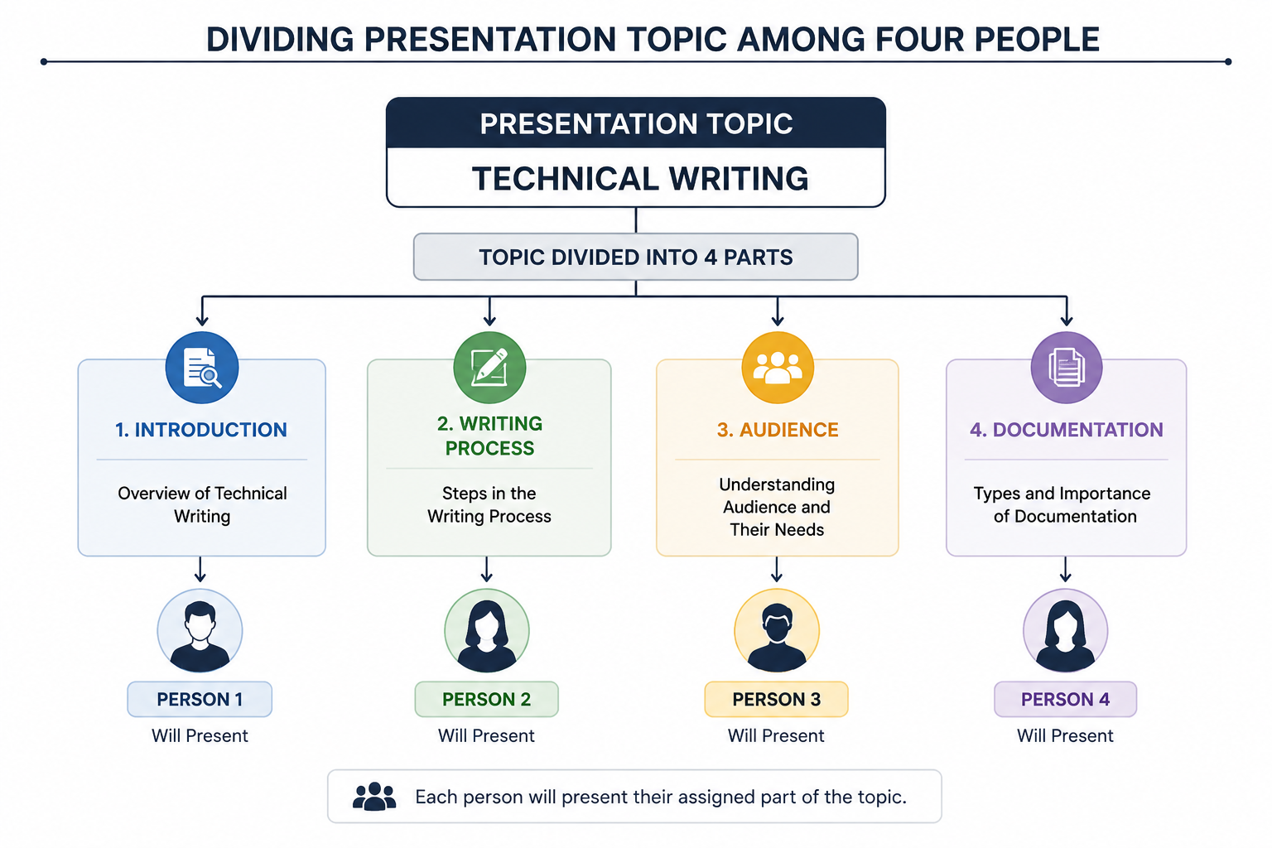
Organizing a Group Presentation: Dividing the Topic
Aayush Shah
Divide the topic into logical sections.
Assign sections according to members' abilities and interests.
Give each member a meaningful and balanced role.
Agree on a common style and overall message.
31

Slide 8


Group Presentation: Setting Time Limits
Aayush Shah
Decide the total presentation time.
Allocate time fairly among speakers.
Set time limits for each section.
Leave time for introduction, conclusion, and questions.
Rehearse with a timer to avoid exceeding the limit.
32

Slide 9

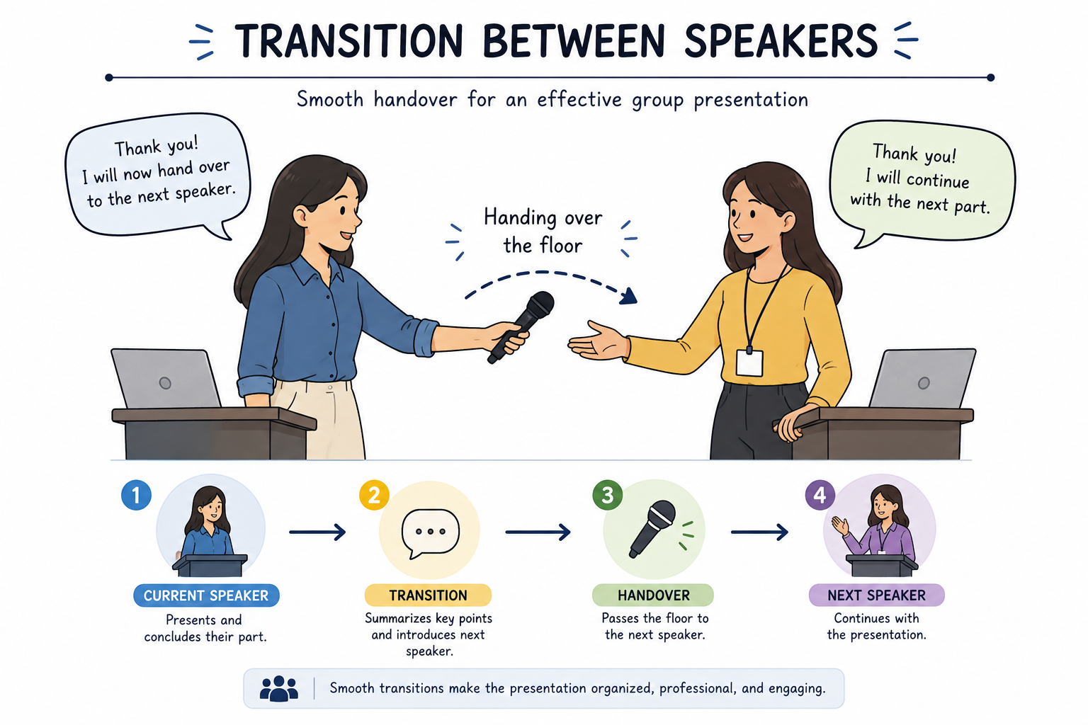
Group Presentation: Transitioning Between Speakers
Aayush Shah
Make the change from one speaker to another smooth and clear.
Briefly summarize the completed section.
Introduce the next speaker or topic.
The next speaker should be ready before the transition.
Example
“Now that we have discussed planning, Member 3 will explain preparation.”
33

Slide 10

Group Presentation: Graphic Aids and Handouts
Aayush Shah
Coordinate slides so the whole presentation has a consistent design.
Assign responsibility for preparing and checking visual aids.
Make sure charts and diagrams are readable.
Provide useful handouts when they add value.
Avoid giving handouts that distract from the presentation.
34

Slide 11


Group Presentation: Answering Questions
Aayush Shah
Decide who will answer different types of questions.
Listen to the complete question before responding.
Answer briefly, clearly, and accurately.
If unsure, acknowledge it rather than guessing.
Other members can add information when necessary.
35

Slide 12

Planning
Planning is the process of deciding what information will be presented and how it will be presented.
It includes analyzing the audience, selecting the topic, choosing visual aids, considering the location, and managing time.
Good planning reduces confusion and helps the speaker stay focused.
It also makes the presentation more organized and effective.

Slide 13


Planning: Audience and Topic
Gaurav Thapa
Audience
The audience determines the type and level of information included in a presentation.
Who are the listeners? What do they already know?
What do they need or expect from the presentation?
Topic
The topic should be clearly defined so that the presentation does not become too broad.
Define the scope and purpose of the topic.
Select information that directly supports the purpose.
4

Slide 14

Planning: Graphic Aids
Gaurav Thapa
Graphic aids are visual materials used to support and explain information.
They include charts, graphs, tables, diagrams, photographs, and illustrations.
They can make complex information easier to understand and remember.
Guidelines for choosing what to illustrate:
Illustrate information that is difficult to explain with words alone.
Use visuals for comparisons, processes, relationships, trends, and complex data.
Choose visuals that improve understanding—not decoration.
5

Slide 15

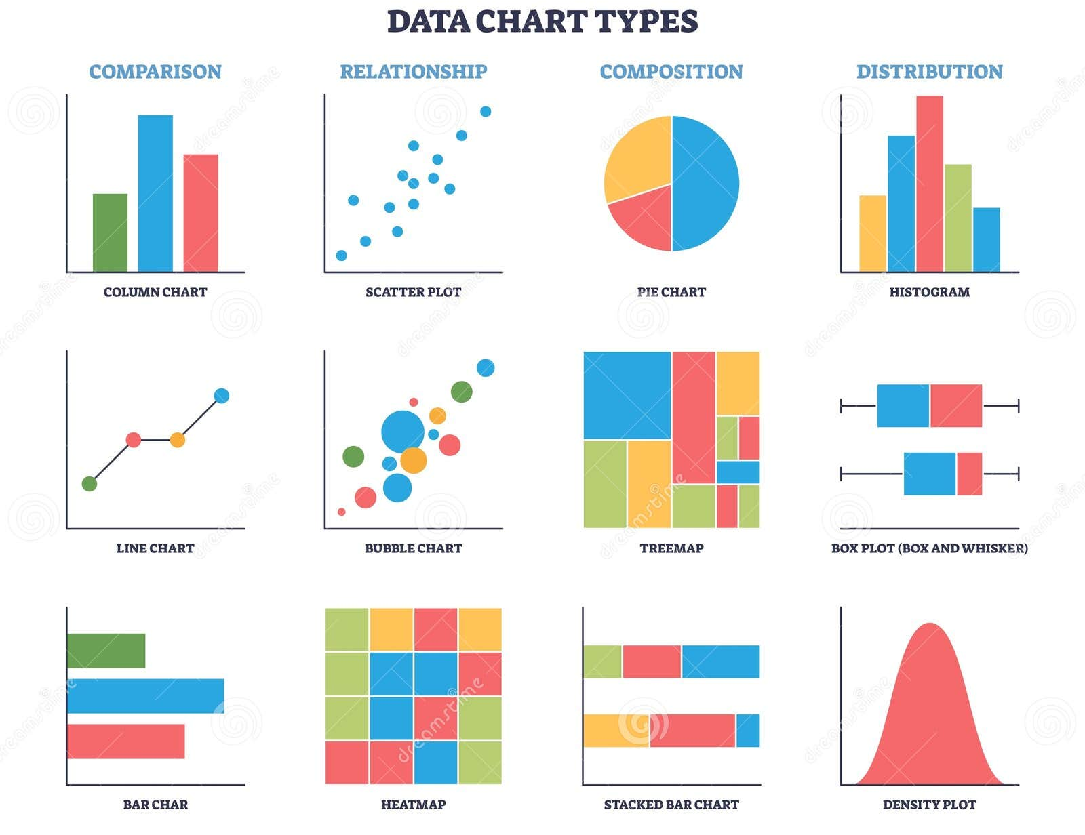

Planning: Types of Graphic Aids
Gaurav Thapa
Charts
Show comparisons or relationships
6

Slide 16
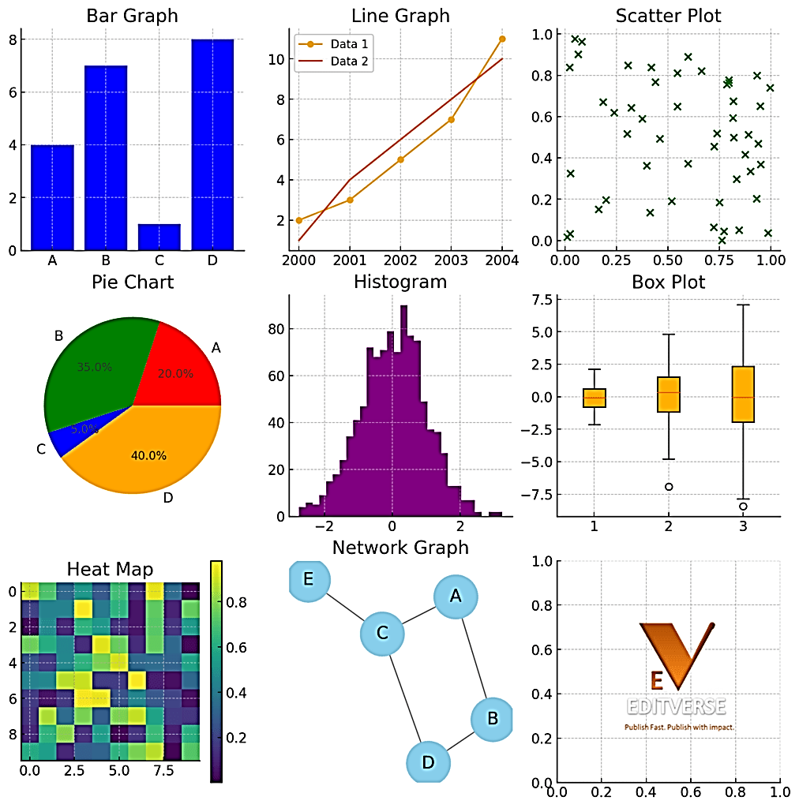

Planning: Types of Graphic Aids
Gaurav Thapa
Graphs
show trends and numerical data
7

Slide 17
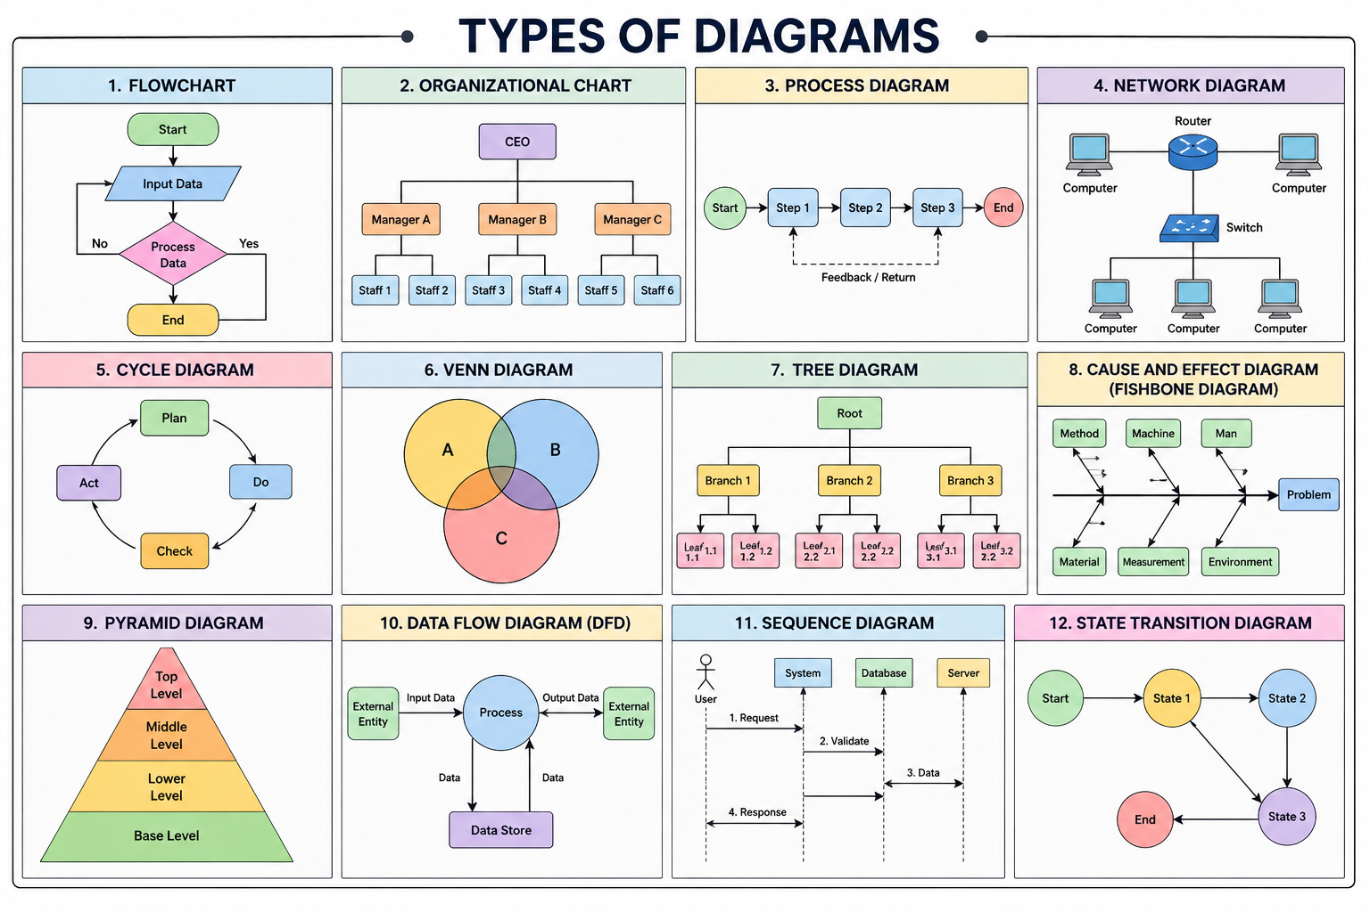

Planning: Types of Graphic Aids
Gaurav Thapa
Diagrams
explain structures or processes
8

Slide 18
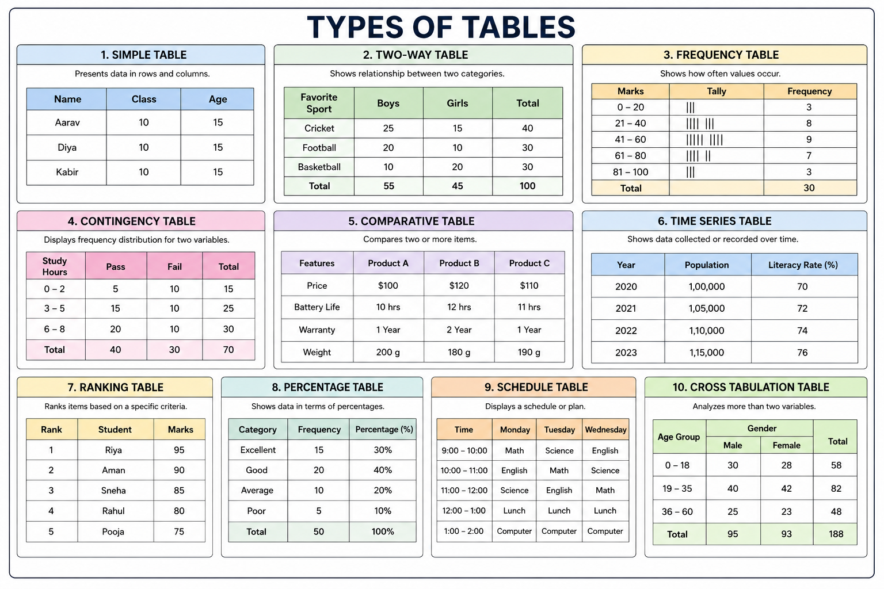
Planning: Types of Graphic Aids
Gaurav Thapa
Tables
organize detailed information
9

Slide 19
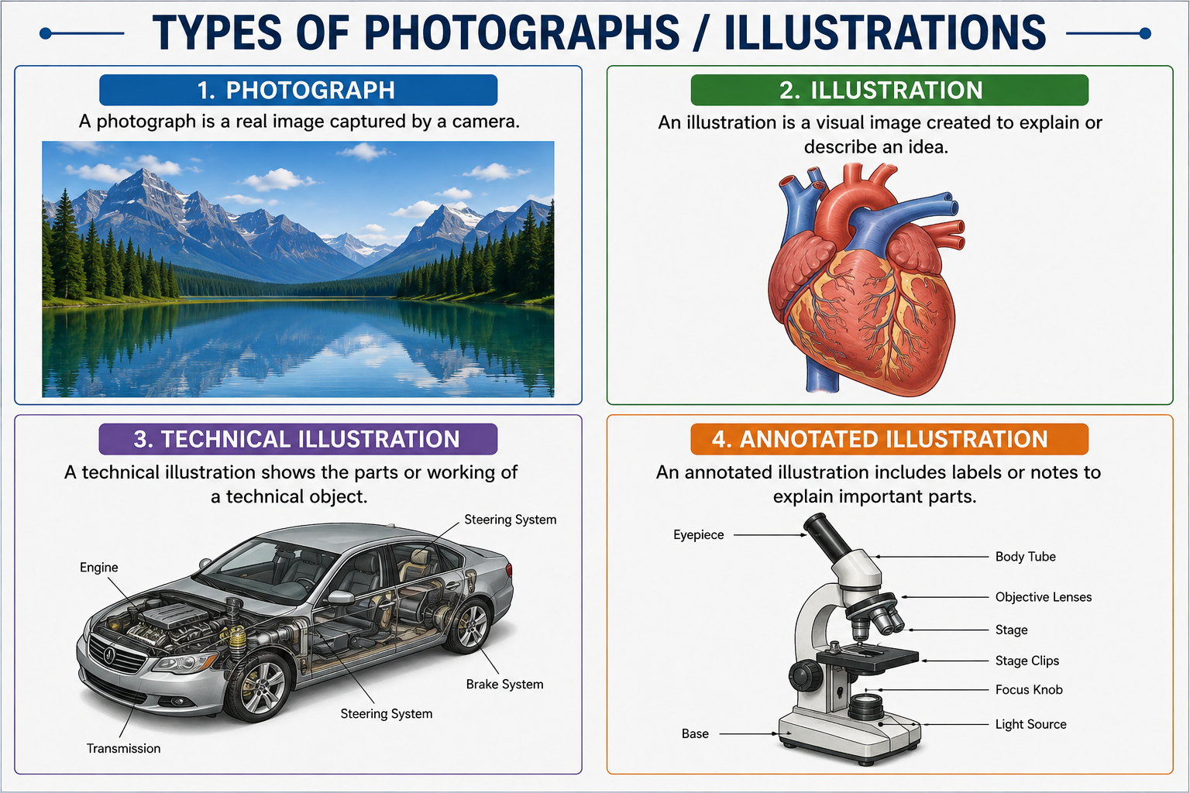

Planning: Types of Graphic Aids
Gaurav Thapa
Photographs / illustrations
show objects or examples
10

Slide 20


Planning: Types of Graphic Aids
Gaurav Thapa
Maps
show location and spatial relationships
11

Slide 21


Planning: Guidelines for Creating Graphic Aids
Gaurav Thapa
Keep the graphic simple and focused.
Use readable labels, fonts, and symbols.
Give each visual a clear purpose.
Avoid unnecessary details and overcrowding.
Make visuals large enough for the audience to see.
Explain the important parts while presenting.
12

Slide 22



Planning: Location
Gaurav Thapa
Location
The location is the physical place where the presentation will take place.
The speaker should understand the room size, seating arrangement, stage position, and visibility.
The location can affect how the speaker moves and interacts with the audience.
Checking the location beforehand helps prevent problems during the presentation.
Time
The speaker should decide how much time to spend on the introduction, body, conclusion, and questions.
Set a realistic time limit and allocate time to each section.
13

Slide 23
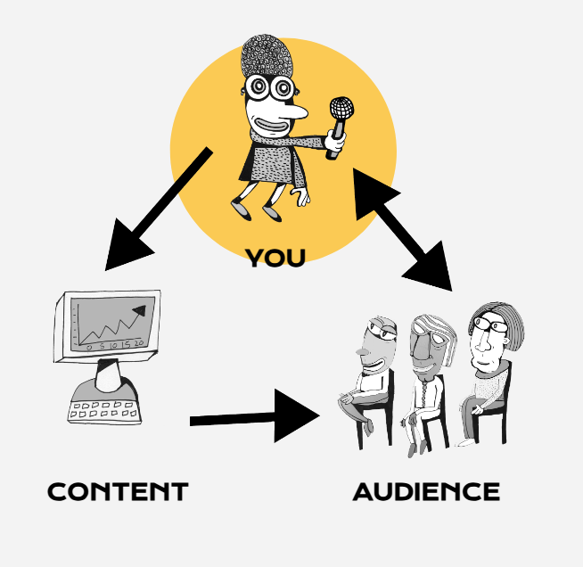
Planning: Audience & Speaker Consideration
Audience considerations
The speaker should consider the audience's knowledge, interests, expectations, and attention span.
Technical information should be explained according to the audience's level of understanding.
The speaker should use language that the audience can easily understand.
Audience reactions should also be observed during the presentation.
Speaker's considerations
The speaker should consider voice, appearance, posture, movement, confidence, and speaking speed.
The speaker should be comfortable with the topic and familiar with the presentation materials.
Clear pronunciation and appropriate volume are important.
The speaker should also maintain eye contact and use natural gestures.
14

Slide 24


Planning: Stage Fright
Gaurav Thapa
Stage fright is nervousness or fear before or during a presentation.
Prepare thoroughly and rehearse several times.
Know the opening and key points well.
Take slow, steady breaths and maintain a comfortable pace.
Focus on communicating the message rather than on being perfect.
15

Slide 25

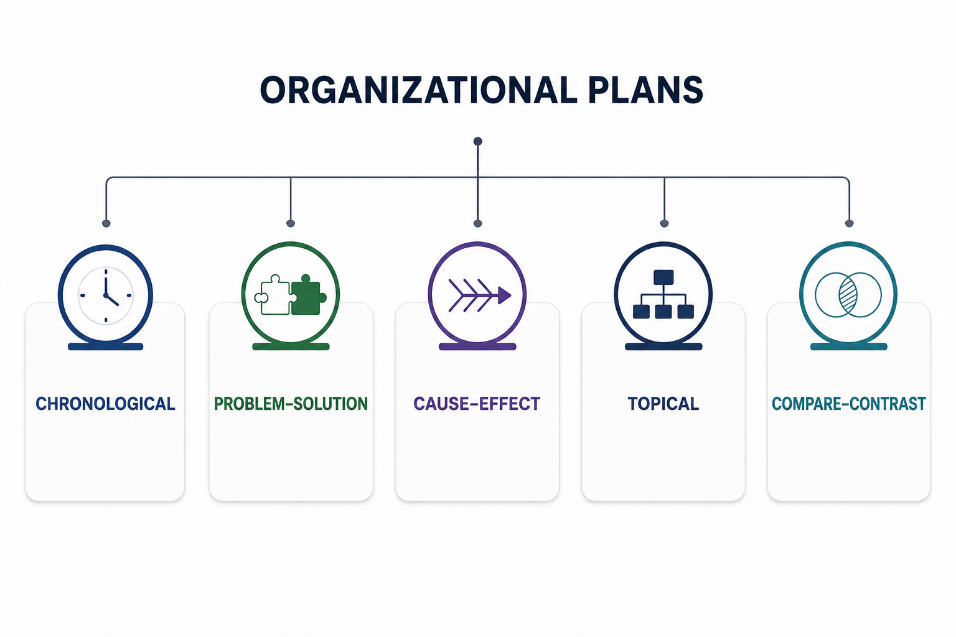
Organizing and Composing: Selecting an Organizational Plan
Gaurav Thapa
Organizing and composing means arranging information in a logical order and turning it into a clear presentation.
A suitable organizational plan helps the audience follow the speaker's ideas.
Choose a structure that fits the purpose and topic.
Common plans include:
Chronological — arranged by time or sequence
Problem–solution — problem followed by possible solutions
Cause–effect — explains causes and results
Topical — divides the subject into major topics
Compare–contrast — shows similarities and differences
16

Slide 26


Organizing and Composing: Previewing Organization
Gaurav Thapa
Tell the audience what the presentation will cover.
Give the main points in the order they will appear.
Help listeners understand the overall structure.
Example
“First, we will discuss planning; next, organization; and finally, delivery.”
17

Slide 27


Organizing and Composing: Composing the Introduction
Gaurav Thapa
An effective introduction should:
Gain the audience's attention.
Introduce the topic.
Establish the purpose.
Explain why the topic matters.
Preview the main points.
18

Slide 28
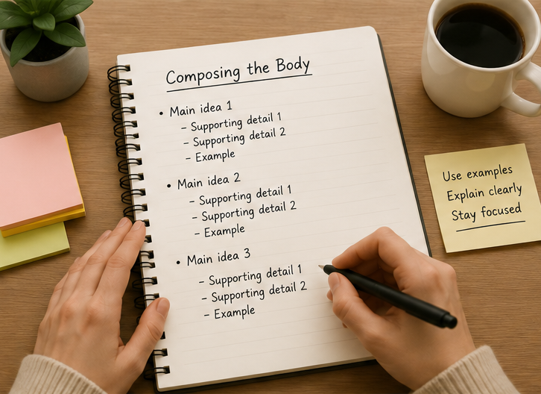
Organizing and Composing: Composing the Body
Gaurav Thapa
Present the main points in a logical order.
Explain ideas with examples, evidence, or graphic aids.
Use transitions between major points.
Keep each section focused on its main idea.
Maintain a balance between detail and available time.
19

Slide 29


Organizing and Composing: Composing the Conclusion
Gaurav Thapa
Signal that the presentation is ending.
Review or summarize the major points.
Reinforce the main message.
End with a memorable final statement, recommendation, or call to action.
Avoid introducing major new information.
20

Slide 30

Preparing
Preparing means getting both the presentation materials and the speaker ready.
The speaker should review the content, prepare slides, organize notes, and check visual aids.
Preparation also includes deciding what to wear and becoming familiar with the presentation environment.

Slide 31
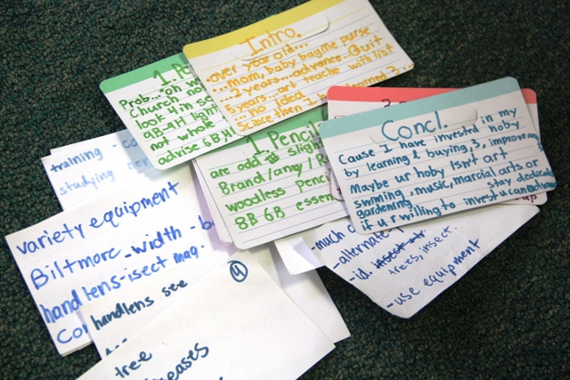
Preparing: Outlines and Notes
Hrikesh Aron
Outlines
Notes
Show the structure and sequence of the presentation.
Help keep ideas organized and complete.
Use keywords and short phrases rather than full paragraphs.
Mark important examples, statistics, transitions, and reminders.
Avoid reading the entire presentation word-for-word.
22

Slide 32

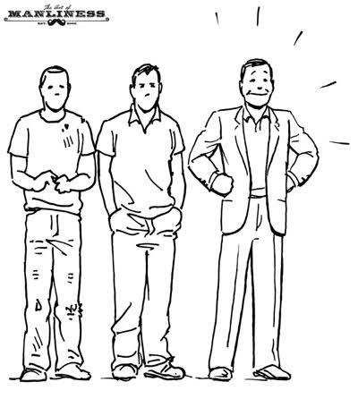
Preparing: Personal Appearance
Hrikesh Aron
Dress appropriately for the audience, topic, and occasion.
Maintain neat and professional appearance.
Choose comfortable clothing that does not distract from the message.
Pay attention to posture, facial expression, and overall confidence.
23

Slide 33

Rehearsing
Rehearsing means practicing the presentation before delivering it to the actual audience.
It helps the speaker improve timing, pronunciation, confidence, and body language.
Practice also helps identify weak or unclear parts of the presentation.

Slide 34


Rehearsing: Using an Audio Recorder
Hrikesh Aron
Record your presentation and listen to it afterward.
Check volume, pronunciation, speed, pauses, and repeated words.
Identify parts that sound unclear or too long.
Practice again after correcting problems.
24

Slide 35


Rehearsing: Using a Mirror
Hrikesh Aron
Practice while looking at yourself.
Observe posture, facial expressions, gestures, and eye contact.
Avoid distracting movements.
Develop a natural and confident delivery.
25

Slide 36


Rehearsing: Using a Video Camera
Hrikesh Aron
Record the complete presentation on video.
Review voice, posture, gestures, eye contact, timing, and slide use.
Notice habits that may distract the audience.
Repeat the presentation after making improvements.
26

Slide 37

Rehearsing: Using a Live Audience
Aayush Shah
Practice in front of classmates, friends, or family.
Ask them to evaluate clarity, organization, delivery, and timing.
Invite questions to simulate the real presentation.
Use feedback to improve before the final presentation.
27

Slide 38
Presenting
Presenting is the actual delivery of the prepared information to the audience.
The speaker should communicate clearly using appropriate voice, body language, eye contact, and visual aids.
The speaker should explain the information instead of simply reading the slides.
Effective delivery keeps the audience interested and helps them understand the message.

Slide 39


Presenting: Checking the Room
Aayush Shah
Before presenting, check:
Seating — Can everyone see and hear clearly?
Lighting — Is the screen visible without making the room too dark?
Temperature — Is the room comfortable?
Equipment — Test the computer, projector, microphone, and other devices.
Graphic aids — Check that slides, charts, and other visuals display correctly.
29

Slide 40


Presenting: Delivering the Message
Aayush Shah
Speak clearly, confidently, and at an appropriate pace.
Maintain eye contact with the audience.
Use natural gestures and appropriate facial expressions.
Explain rather than simply read the slides.
Use transitions to connect ideas.
Listen and respond respectfully to audience questions.
30

Slide 41


Conclusion
Kamana Shrestha
An effective presentation requires:
Understanding the audience and purpose
Careful planning and organization
Clear composition and useful graphic aids
Preparation and rehearsal
Confident delivery
Strong coordination in group presentations
36

Slide 42

Feedbacks
37

Slide 43
Questions?
37

Slide 44
Thank You
37

